Slide 1
Artify - Encouraging students in learning art through a virtual gallery application
Bachelor thesis, Burcu Hadimoglu 01228630
Supervisor: Univ.-Prof. DI Dr.techn. Fares Kayali

Slide 2
Agenda
Goal
Artify Application
Method
Findings

Slide 3
Observation:
Digitalization is taking over more place in the lives of the younger generation and they are spending more time online
Our Goal:
To use this to find out if a virtual gallery application that integrates with the user can motivate students to better learn about art

Slide 4
Artify Application
Home
All paintings listed and categorized under art movements
Tutorial
Video tutorials about specific paintings
Quiz
Quiz Section for users to test themselves
Profile
Users’ own drawing gallery

Slide 5
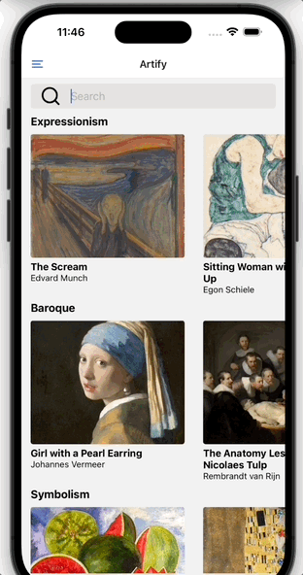
Home Screen
The recording shows the home page of the Artify application
On this page, all the paintings are listed and they are categorized under different movements

Slide 6
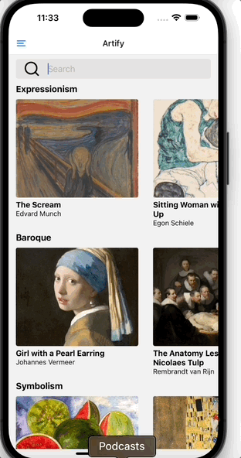
Navigation
Navigation
The navigation bar is located on the right side of the screen
It is possible for users to switch between three main pages:
Artify Screen (Home)
Quiz Screen
Profile Screen

Slide 7
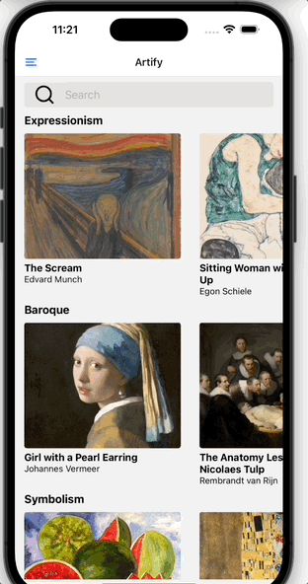
Search Functionality
The recording shows the search functionality.
Users can use the search bar on the top of the screen to search for specific paintings or artists.

Slide 8
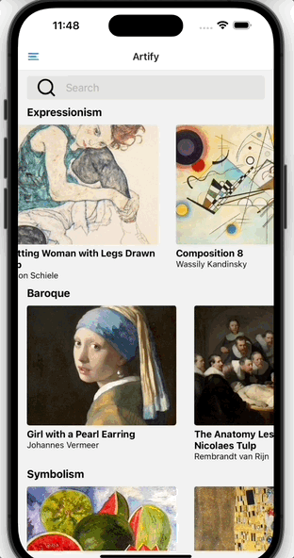
Painting Screen & Tutorial
User can find tutorials when the user clicks on a painting thumbnail on the home screen
The next screen gives a better overview of the selected painting with a bigger image of the painting and detailed information about the selected work
User can find tutorial videos when clicked on the tutorial button

Slide 9
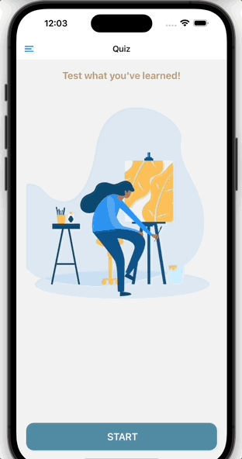
Quiz Screen
The recording shows the quiz feature of the application
User can navigate through the left navigation bar to quiz screen
Quiz question screens can be seen on the screen and user can go to next question by clicking on next button.
Last screen is the final screen of the quiz
User can preview their result and either retry the quiz or navigate back to the home page

Slide 10
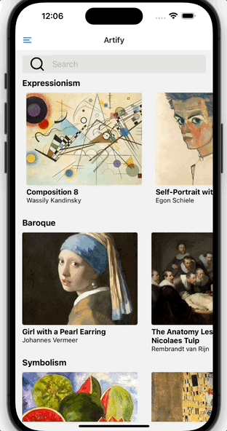
Camera Screen
User can take photos of their own drawings of a specific painting and save them inside the application
The photos can be viewed from the profile screen
It is also possible for users to save the photo in their device or share it with their friends

Slide 11
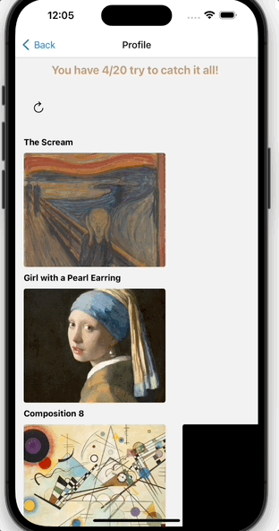
Profile Screen
Users can create their own gallery on this screen
The drawings that users took a photo of will appear on this page together
They can add multiple drawings for one painting

Slide 12
Method

Slide 13



Technical Implementation
React native logo taken from: https://ubidreams.fr/en/expertises/development/react-native
Expo Cli logo taken from: https://github.com/expo/expo
Firebase logo taken from: https://manuelernest0.medium.com/the-journey-of-firebase-realtime-database-42cc6cc5d8b3

Slide 14
Participants & Data Collection
10 participants
Interviews present or through Zoom meetings
50 - 60 minutes

Slide 15
Data Analysis
Thematic Analysis
Qualitative Data Codes Themes

Slide 16
Qualitative Data
Burcu Aleksandar | 1) How did you first get in touch with art? I remember having art classes in my primary school and we used to draw something different each week. I remember it was with different styles like watercolour or gouache or different painting types. The second thing I remember about that is we had a strict art teacher in high school and he wanted us to know paintings by heart with artists and times.
Burcu Damla | 1) How did you first get in touch with art? I grew up in a family full of art. I have been exposed to art since I was very little.
Burcu Anita | 1) How did you first get in touch with art? I met through my brother. He was always interested in arts and did sculptures and drawings. He also works in this area today.

Slide 17
Codes
Burcu Aleksandar | 1) How did you first get in touch with art? I remember having art classes in my primary school and we used to draw something different each week. I remember it was with different styles like watercolour or gouache or different painting types. The second thing I remember about that is we had a strict art teacher in high school and he wanted us to know paintings by heart with artists and times.
Art classes at school
Burcu Damla | 1) How did you first get in touch with art? I grew up in a family full of art. I have been exposed to art since I was very little.
Meeting through family
Burcu Anita | 1) How did you first get in touch with art? I met through my brother. He was always interested in arts and did sculptures and drawings. He also works in this area today.
Family profession in arts

Slide 18
Iterative Comparison
Q1) How did you first get in touch with art?
Art classes at school Meeting through family at an early age Family brought to a museum as a kid and fall in love Started drawing with Bob Ross on tv Family bought art books Started drawing cartoon characters as a young kid Drawing activities in preschool

Slide 19
Themes
Q1) How did you first get in touch with art? | Theme | Percentage
Meeting through family at an early age Family profession in arts Proceeded to study in arts later Family brought to a museum as a kid and fell in love Family bought art books | Family | 50%
Art classes at school Drawing activities in preschool | School | 30%
Started drawing with Bob Ross programs Started drawing cartoon characters as a young kid | Media | 20%

Slide 20
Findings

Slide 21
How would you expect digitalization would support user experience in painting exhibitions more in the future? | Theme | Percentage
Common applications to prepare me before exhibitions Accessible applications to filter information Video tutorials about the paintings inside the specific exhibition | Accessible Information | 60%
VR glasses making you feel in the painting Interactive paintings AR to extend exhibitions in large spaces | Interaction with the Art | 40%
QR codes for artists to get direct feedback | Interaction with the Artist | 10%
Analyse user mistakes in exhibitions and fix them | Improve User Mistakes | 10%

Slide 22
Do you think it would change your class experience in a museum if you had this application in your school when you were a student, and how? | Theme | Percentage
Fast access and save time Avoid information loss More freedom due to not taking notes of everything Provide information that is not enough in the class no artist or artwork knowledge, in the end, stays in memory | Efficient | 90%
Share and compare paintings with other students Not boring class experience getting the same information as everyone Allow more creativity | Fun | 80%
Various examples to expand and shows no style is false More sources of what is learned in class Inspiration due to more sources besides media | Diversity | 60%

Slide 23
As can be seen in the previous tables, there are different expectations of digitalization support in exhibitions.
We observed these kinds of applications are new for the users even though they enjoyed the gamification concept of the application and they found it helpful.
Our findings showed us virtual gallery tours are not for every user.
Users who met with art at an earlier age seem to be more interested and involved in this case, they prefer digitalization as a feature to support their experience in museums. The users who met later in life seem to be more open and enjoy when digitalization becomes more of the center of the exhibition topic.

